Slide 1
RESEARCH PROJECT REPORT IN FULFILMENT OF SUMMER INTERNSHIP PROJECT
TOPIC:
BI TRIANGLE
SUBMITTED BY: SUBMITTED TO:
Saniya Usmani Shashwat Singhal

Slide 2
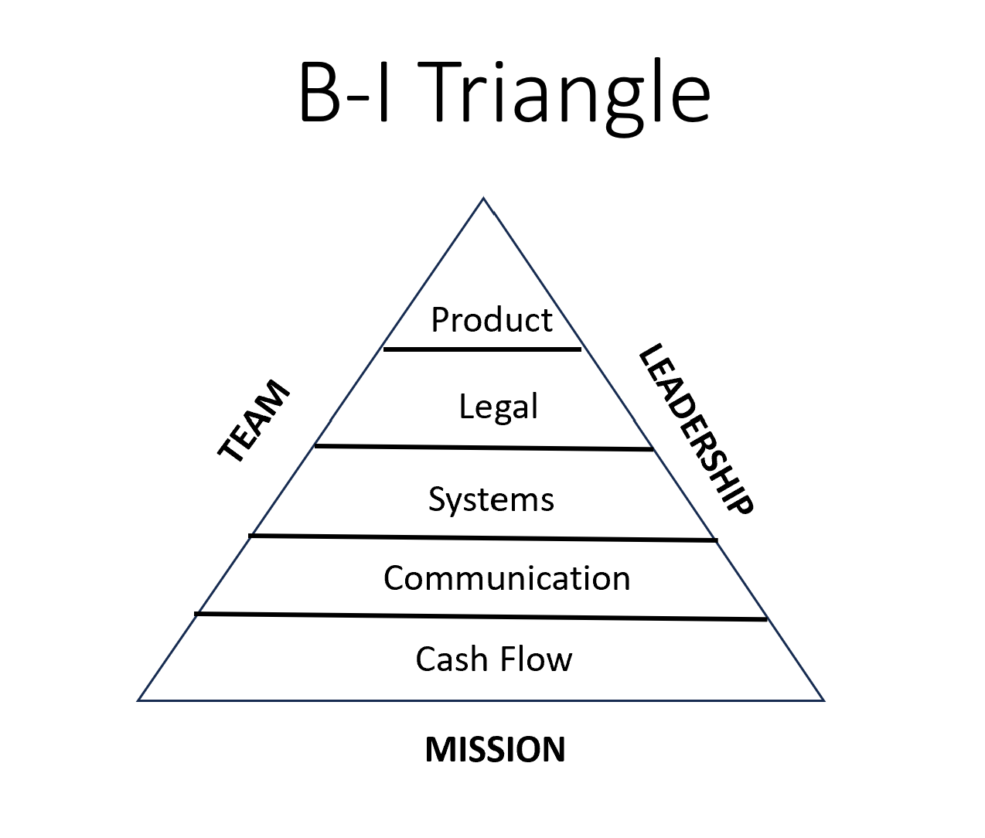
What is the B-I Triangle?
The B-I Triangle is a business framework that organizes the essential elements required for building a successful and sustainable organization.
It emphasizes:
Strong business foundations
Effective leadership
High-performing teams
Continuous product excellence

Slide 3
Structure of the B-I Triangle
The triangle is built from the bottom upward:
Mission (Foundation)
Cash Flow
Communication
Systems
Legal
Product (Top)
Supporting the entire framework:
Team
Leadership

Slide 4

Mission – The Foundation
The mission defines:
Purpose
Vision
Core values
Long-term direction
A clear mission helps:
Align employees
Guide decision-making
Inspire customers
Build company culture

Slide 5
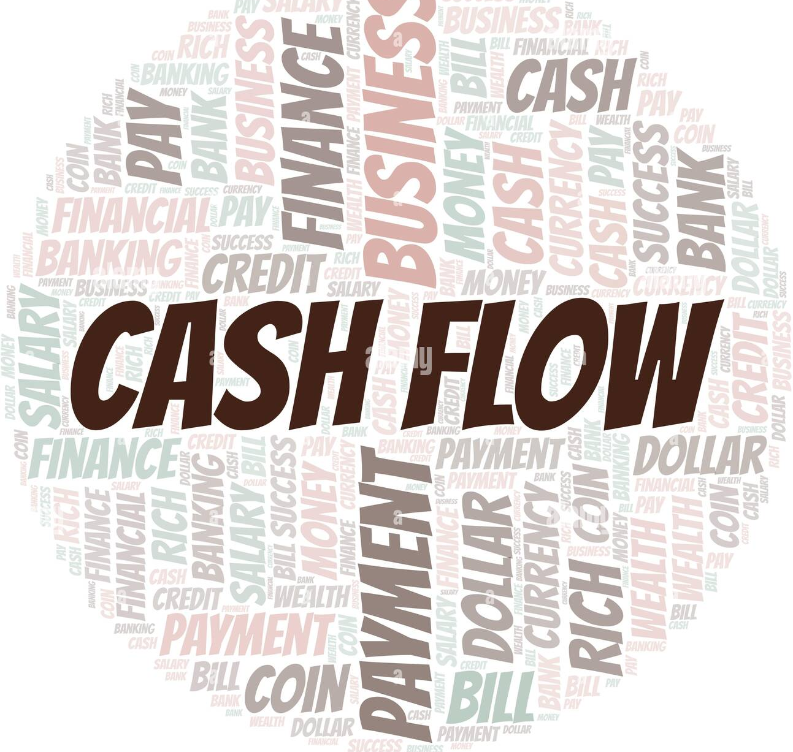
Cash Flow – The Lifeline
Healthy cash flow ensures:
Operational stability
Business growth
Employee salaries
Investment opportunities
Financial resilience
Key Practices:
Budget planning
Expense management
Revenue monitoring
Emergency reserves

Slide 6

Communication – Connecting the Organization
Effective Communication Builds Success
Strong communication leads to:
Better teamwork
Faster decisions
Higher productivity
Customer satisfaction
Reduced misunderstandings
Communication should flow:
Upward
Downward
Across department

Slide 7

Systems – Creating Consistency
Why Systems Matter
Systems transform effort into repeatable success.
Examples:
Standard Operating Procedures (SOPs)
Automation
CRM systems
Project management tools
Quality control

Slide 8
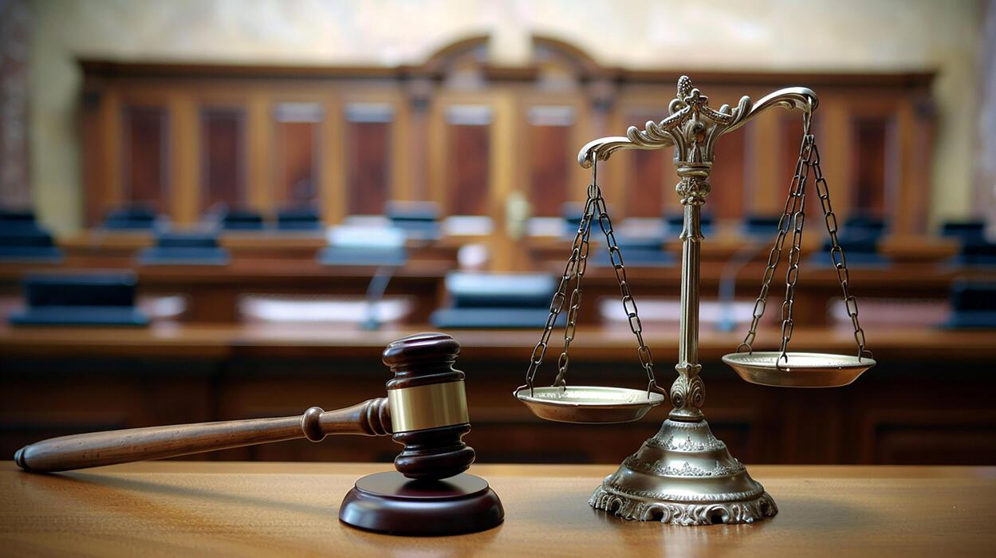
Legal – Protecting the Business
Legal Compliance
A business must operate within legal boundaries.
Areas include:
Business registration
Contracts
Intellectual property
Employment laws
Tax compliance
Data privacy

Slide 9
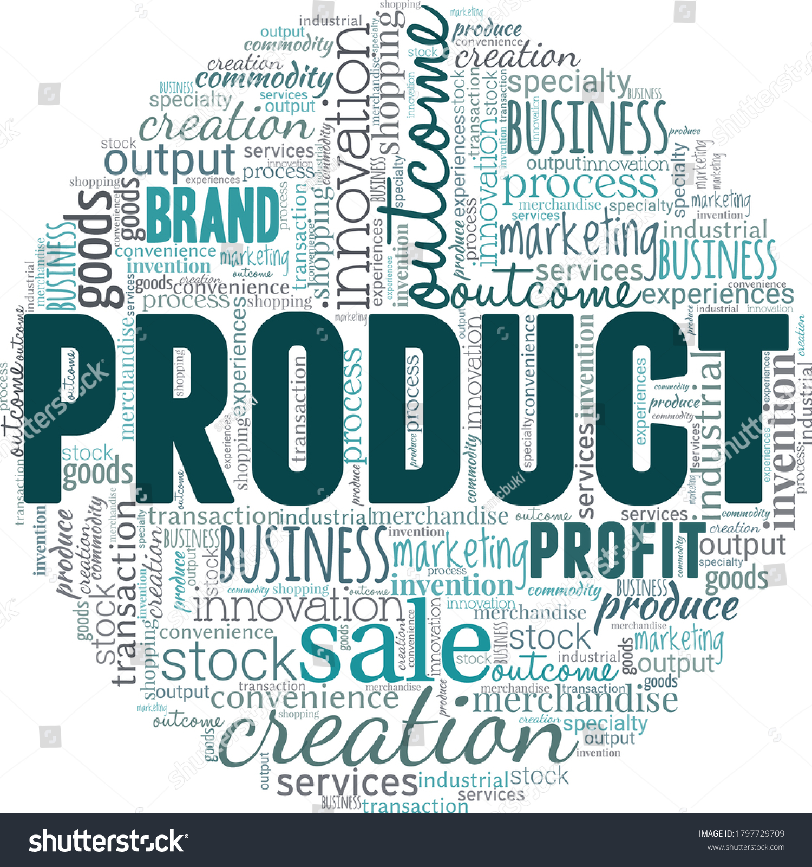
Product – Delivering Value
The Top of the Triangle
The product represents the outcome of all supporting business functions.
A successful product should:
Solve customer problems
Deliver quality
Be innovative
Meet market demand
Continuously improve

Slide 10

Team
Team
A strong team provides:
Skills
Collaboration
Accountability
Innovation

Slide 11
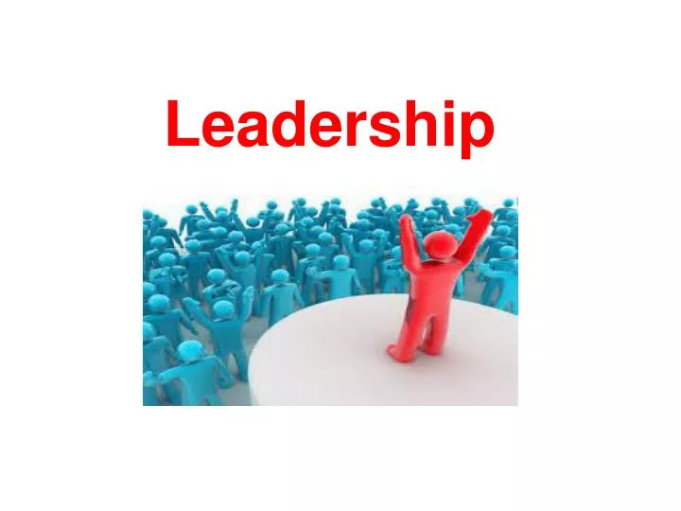
Leadership
Leadership
Effective leadership ensures:
Vision
Decision-making
Motivation
Culture
Strategic direction

Slide 12
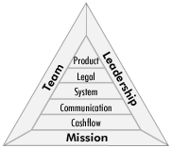
Conclusion
The B-I Triangle demonstrates that sustainable business success requires:
A clear mission
Strong financial management
Open communication
Efficient systems
Legal compliance
Excellent products
Great teams
Effective leadership

